Slide 1
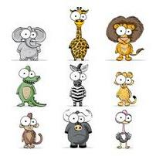
ANIMALS !!!

Slide 2
Animals
Click on the following images and listen to each animal sound. ☺
1 2 3 4
5 6 7 8

Slide 3
What is the animal that jumps and lives in a swamp ?
Rooster Dog Horse Sheep
Cat Frog Monkey Cow

Slide 4
WRONG ANSWER !!! TRY AGAIN !!!

Slide 5
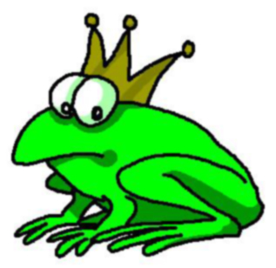
IT’S A FROG !!!

Slide 6
What is the animal that lives in a farm and makes milk ?
Rooster Dog Horse Sheep
Cat Frog Monkey Cow

Slide 7
WRONG ANSWER !!! TRY AGAIN !!!

Slide 8
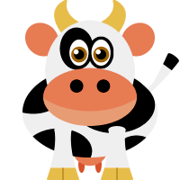
IT’S A COW !!!

Slide 9
WRONG ANSWER !!! TRY AGAIN !!!

Slide 10
What is the animal that eats bananas and climbs in the trees ?
Rooster Dog Horse Sheep
Cat Frog Monkey Cow

Slide 11
IT’S A MONKEY !!!

Slide 12
WRONG ANSWER !!! TRY AGAIN !!!

Slide 13
What is the animal that eats mice and drinks milk ?
Rooster Dog Horse Sheep
Cat Frog Monkey Cow

Slide 14
WRONG ANSWER !!! TRY AGAIN !!!

Slide 15
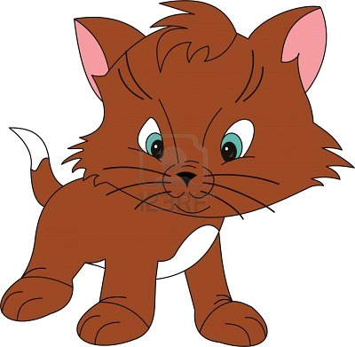
IT’S A CAT !!!

Slide 16
What is the animal that cowboys ride ?
Rooster Dog Horse Sheep
Cat Frog Monkey Cow

Slide 17
WRONG ANSWER !!! TRY AGAIN !!!

Slide 18
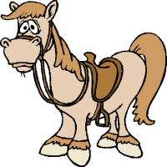
IT’S A HORSE !!!

Slide 19
What is the animal that makes the ‘’Meeeehs’’ sound ?
Rooster Dog Horse Sheep
Cat Frog Monkey Cow

Slide 20
WRONG ANSWER !!! TRY AGAIN !!!

Slide 21
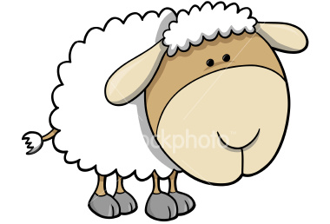
It’s a SHEEP !!!

Slide 22
What is the animal that wakes you up in the morning ?
Rooster Dog Horse Sheep
Cat Frog Monkey Cow

Slide 23
WRONG ANSWER !!! TRY AGAIN !!!

Slide 24
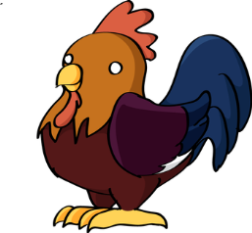
IT’S A ROOSTER !!!

Slide 25
What is the animal that barks and eats your shoes ?
Rooster Dog Horse Sheep
Cat Frog Monkey Cow

Slide 26
WRONG ANSWER !!! TRY AGAIN !!!

Slide 27
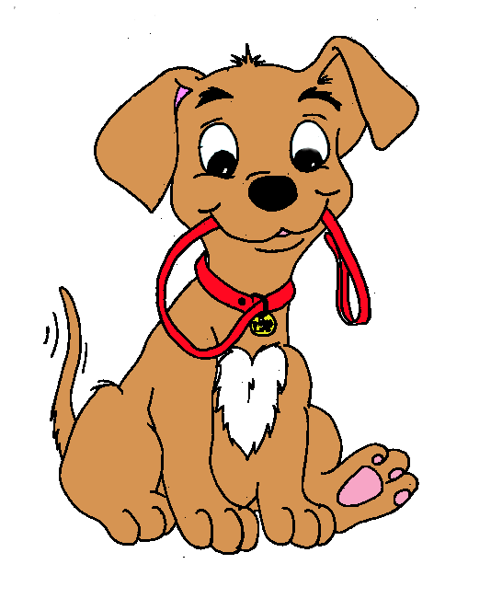
IT’S A DOG !!!

Slide 28
CONGRATULATIONS !!!

